Slide 1
Buckingham Design code: 2024 - 2040
Created by Buckingham Town Council
With Roger Newall, ONH, The Buckingham Neighbourhood Development Plan Working Group and the residents and businesses of Buckingham

Slide 2
contents
Introduction 3
Context 6
Movement 19
Nature 23
Identity 31
Public Spaces 35
Homes & Buildings 41
Resources 45
Planning Applications 47
Buckingham viewed from the west. “This image was taken in the month of September and illustrates the importance of tree cover to the setting of the town. Increasing the tree cover both within the town, and in particular new developments within an extended urban area, will assist with the integration of new housing together with combating the effects of climate change.”

Slide 3
introduction
HISTORY
The Buckingham Design Guidelines originate from 2001 and were partly adopted by the then local planning authority Aylesbury Vale District Council.
As we look to update the Buckingham Neighbourhood Plan, the revised National Planning Policy Framework (NPPF) July 2021 introduces the opportunity for Town/Parish Councils to produce design codes for their local area of responsibility, which are linked to Neighbourhood Plans. This draft Code is reflective of advice contained within the National Design Code Model.
A BUCKINGHAM DESIGN CODE
Design codes are a set of illustrated design rules and requirements which instruct, and may advise on, the physical development of a site or area. The graphic and written components of the code are detailed and precise and build upon a design vision such as a masterplan or other design framework for a site or area, in this case the Buckingham Neighbourhood Plan. The codes set out the mandatory baseline minimum standard that is to be adopted for new developments at Buckingham.
This draft design code has been prepared jointly by the Buckingham Town Council and the Buckingham Society and replaces the previously adopted Buckingham Design Guidelines. Its purpose is to provide a coherent framework to future development of land throughout Buckingham and to define the character of new developments and give clear guidance on what will be considered acceptable to the local community and will be included as an Appendix to the Neighbourhood Plan.
The code also includes requirements for adaptable and wheelchair user dwellings, details of how new development can achieve net zero carbon emissions, help to minimise flooding, and water harvesting/recycling.

Slide 4
This is essentially about places and people’s relationship with them; it is as much about the commonplace as about the rare, about the everyday as much as the endangered, and about the ordinary as much as the spectacular. Definition of local distinctiveness is intricately linked to the environment, the economy, and the social ambience of a place and has been defined as that which makes a place special, differentiating it from anywhere else. Local distinctiveness is the essence of what makes a place special to us; it is the sum of landscape, wildlife, archaeology, history, traditions, buildings and crafts – everything that makes somewhere truly unique, and of course peoples’ memory of a place. In this respect all new developments, be they houses, extensions or employment buildings, should have their design influenced by local distinctiveness.
Local distinctiveness
However, this should not preclude contemporary designs, including modular buildings, provided they reflect local distinctiveness and/or the surrounding environment, then they should be encouraged.
Bourton Park

Slide 5
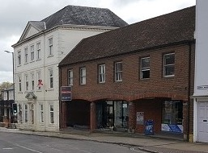
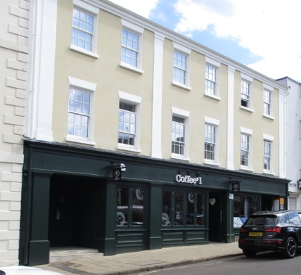
Local distinctiveness
Use of local distinctiveness in redevelopment
1960s bank – originally NatWest, on Market Hill, Buckingham, inside the conservation area
Finished redevelopment in 2022

Slide 6
CONTEXT
Buckingham is a market town located in the north of Buckinghamshire approximately 17 miles north-west of Aylesbury and 12 miles south-west of Milton Keynes. The historic core of Buckingham was designated as a Conservation Area in 1971 and the boundary was revised in 2005.
The historic core of Buckingham is situated on a raised promontory and is largely contained within a sweeping bend of the River Great Ouse. The winding form of the river, its floodplains and crossing points have shaped the physical character of the town and defined its strategic and economic importance.
There are many changes in levels within the town form, an important element of its character and former strategic importance. Rising ground gives emphasis and grandeur to individual buildings such as the Church of St. Peter and St. Paul and allows expansive views across the surrounding countryside. In contrast, the lower-level ground along the river has a much more intimate character.
Buckingham Old Gaol - Rukiah Macey
The Flosh and Lord’s Bridge

Slide 7
CONTEXT
Although there is an overall 18th century flavour to the town, many of the individual streets have quite an eclectic character, with buildings varying in scale, height, roof form, width of elevation and architectural detailing. In addition, interesting juxtapositions exist between the grander public structures and town houses and the smaller and much simpler domestic dwellings.
Key elements in the historic character of Buckingham are the materials used in the construction of buildings and street surfacing. The geology of the Buckingham area consists of limestone, clay and cornbrash deposits and these materials provide the basic elements in the construction of historic buildings prior to the 19th century when the arrival of the railway and canal introduced cheaper, mass-produced building materials, such as slate.
Several buildings within the town are rendered or painted, which provides an interesting contrast in surface treatment and textures.
New estate developments post 1945 have occurred within and adjoining the town and its historic core, many of which have paid little or no attention to the characteristics or local distinctiveness of Buckingham. These draft design codes are an attempt to redress the balance so that new developments respect that which makes Buckingham special.

Slide 8
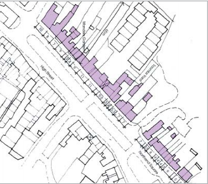
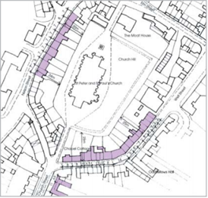
The map shows the typical block structure and historic street pattern of the centre of Buckingham. It highlights how the town developed in this form with all buildings fronting onto the street/s or River Great Ouse, together with the regular and diverse plot sizes in differing locations.
CONTEXT
LOCAL CHARACTER ANALYSIS: BUILT FORM
URBAN MORPHOLOGY: TOWN CENTRE
High Street - varied dwelling/plot widths and depths. Perimeter blocks with carriageways through to mews/developments behind
Parts of Nelson Street and Well Street - perimeter blocks with more regular plot width and depth

Slide 9
Carriage entrances are a common feature within the long-built terraces of Buckingham; two examples are shown here.
CONTEXT
LOCAL CHARACTER ANALYSIS: BUILT FORM
BUILDINGS WITH CARRIAGE ENTRANCES
CORNER BUILDINGS
Buckingham has a wealth of uniquely designed buildings sited at corner locations; two examples are here, one historic and one contemporary.
Castle Street
Well Street
High Street
Whitehead Way

Slide 10
The roof covering most widely used in Buckingham is plain clay tiles. Several later buildings have natural slate roofs, which also allows the provision of shallower roof slopes. This variation should be reflected within new developments at Buckingham.
CONTEXT
Local character analysis: roofscapes
TILES
RIDGE HEIGHTS
Ridge heights are generally uniform however, many of the individual streets have quite an eclectic character with buildings varying in scale, height, roof form, width of elevation and materials. Many buildings in the town have dormer windows, which are traditionally proportioned and do not dominate the street scene.
As illustrated in the images all dwellings shown have chimney stacks, which shall be replicated on all new pitched roof dwellings proposed within the Buckingham Neighbourhood Plan area.
High Street – variety of ridge heights
Natural slate tile and plain clay tile
Dormer windows positioned away from ridge
Nelson Street – ridge lines follow slope of the land

Slide 11
Local character analysis: Walls
CONTEXT
The most common wall finish within Buckingham is brick, particularly of an orange/red hue. Historically these have been laid in Flemish bond, and this practice has been continued within recent developments at Moreton Road, Lace Hill, and Summerhouse Hill.
There are many examples of decorative brickwork throughout Buckingham, particularly from the Victorian era. The former Lloyds Bank building in the town centre and the image from Chandos Road shown below are examples of this practice.
Yellow bricks have been used but to a far lesser extent, most notably at Markhams Court and Villiers Hotel annexe.
Local limestone buildings are interspersed throughout the town, whilst painted brickwork of varying colours can be seen along with stucco and render.
Flemish bond with vitreous headers
Flemish bond with pale headers
Flemish bond
Painted English bond brickwork
Yellow bricks laid in Flemish bond
Coursed limestone rubble

Slide 12
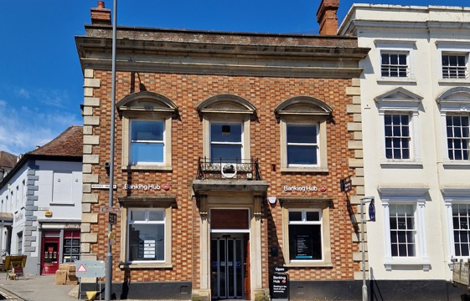
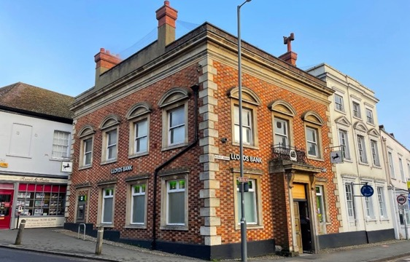
CONTEXT
Decorative Victorian brickwork in Chandos Road
Flemish bond brickwork with pale headers at the Banking Hub

Slide 13
Pargeting is a decorative form of external plaster work or waterproof plastering applied to building walls. There are some examples of this practice within Buckingham, most notably in Castle Street, as indicated by the image below. This is achieved by placing several pins in a board in certain lines or curves, and then pressing on the wet plaster in various directions, to form geometrical figures, and commonly found in panels of timber framed buildings.
CONTEXT
Local character analysis: decoration
PARGETING
STUCCO
Stucco is seen most commonly within Nelson Street, Bristle Hill, Hunter Street, and Church Street. Stucco consists of lime, sand, and water, and within Buckingham is commonly ‘decorated’ with incised masonry patterning. Many stucco finishes have been painted a variety of colours as can be seen in the images below,
The incised masonry pattern
The Coach House, Castle Street
Nelson Street
Bristle Hill

Slide 14
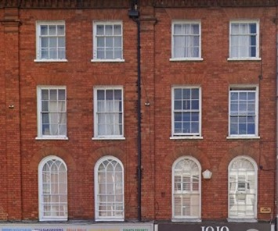
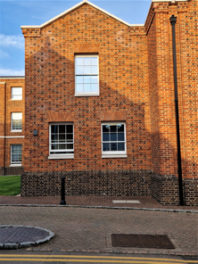
CONTEXT
Local character analysis: DOORS AND WINDOWS
The above image shows door and window styles found throughout Buckingham; the bay window is extended to ground level, a 6 panel door with a simple canopy, and Georgian style sash windows.
A flat arch voussoir is above the ground floor window whilst the upper floor window heads are directly below the eaves.
Also shown are the door and window reveals, which should be repeated in new dwellings.
Windows in Market Square – note the curved frames and how openings decrease in size on the upper floors.
Flemish bond brickwork, decorative cornice, flat arch voussiors, and deep window reveals to recently constructed building at Buckingham University, details that reflect the local distinctiveness of Buckingham.

Slide 15
Buckingham has a wealth of differing chimney styles, and it is possible to reflect this within modern house designs.
CONTEXT
Local character analysis: CHIMNEYS
Historic twisted chimney attached to grade 2* listed building and dating from the 16th century.
Modern interpretation of the historic chimney erected in 2012.

Slide 16
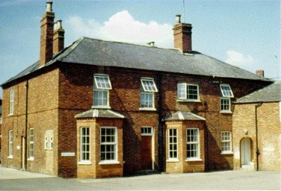
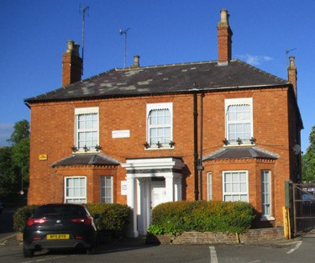
The site location relates very much to the history of the Buckingham branch of the Grand Union Canal. The canal arm from Cosgrove to Buckingham was opened in 1801 and terminated at Wharf Yard to the east of the town centre. After initial commercial success, it was abandoned in 1964. Many of the buildings associated with the canal have since been abandoned or demolished. However, there are three remaining buildings in the town, together with the more general early 19th century development of the town, that provide an appropriate design cue for the new canal area. The first is wharf house, which sits in a prominent location on stratford road at the entrance to the former canal wharf, now used for various commercial enterprises. Wharf house is listed as a non-designated heritage asset and is within the buckingham conservation area. The building is of a grander scale in its form, height and tall chimneys, with pronounced bay windows. It has a large, double hipped slate roof and the red brick common to the town.
CONTEXT
LOCAL CHARACTER ANALYSIS: CANAL SIDE
Wharf house eastern elevation
Buckinghamshire County Council Archive
Wharf house western elevation

Slide 17
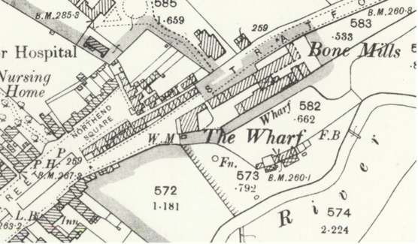
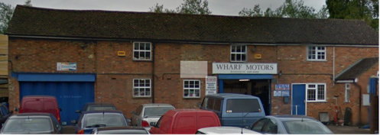
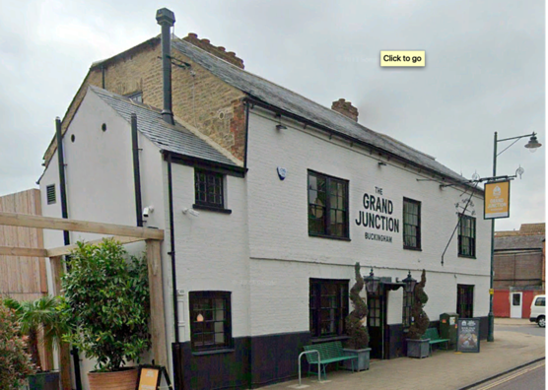
The second is the range of buildings that also survive in the former wharf area, which are occupied by Wharf Motors. The range is smaller in scale, also in red brick but with a lower, clay tile roof.
CONTEXT
LOCAL CHARACTER ANALYSIS: CANAL SIDE
The Wharf, off Stratford Road, Buckingham 1898 (Source: National Library of Scotland)
The Grand Junction, Google Street View © 2024
Wharf Motors, Google Street View © 2024
The third building is The Grand Junction public house at 12-13 high street, which is contemporaneous with the opening and operation of the canal and is grade II listed. It is of a similar scale to wharf house, with a half hipped slate roof and painted (red) brick frontage with coursed limestone rubble. Its listing description associates the building With the canal and wharf house.
The three buildings are of typologies, the use of which in the canal area scheme will reassert the history of the canal with the town. The typologies will offer the opportunity to create a range of terraced and detached building forms of a variety of heights within a two storey form. The use of similar building materials in the palette for the area will also make a subtle cross reference to its association with the town even though the site itself lies beyond its easternmost boundary.

Slide 18
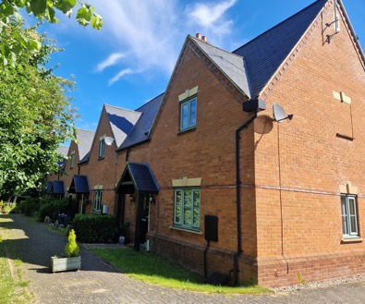
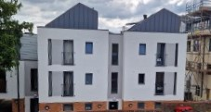
CONTEXT
Local character analysis: contemporary and other interpretations of house design
Examples of contemporary house design within the Buckingham area.
Lace Hill dwellings reflecting almshouse design
For further street analyses refer to the area studies contained within the adopted Buckingham Conservation Area document dated 27 April 2005.

Slide 19
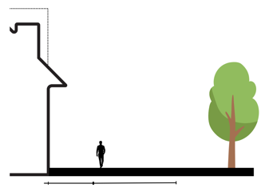
MOVEMENT
M.2.ii. JUNCTIONS & CROSSINGS
ROAD JUNCTIONS
Design speed
FORWARD VISIBILITY
10 mph
Junctions must have minimum junction radii acceptable to ease pedestrian crossing and slow traffic speeds consistent with Manual for Streets.
Consistent with current best practice advice buildings should define and enclose streets. Positioning of buildings can be used to limit forward visibility and therefore assist in the reduction of vehicle speeds.
Carriageway (width)
SHARED PRIVATE DRIVES
4.5m
Shared private drives are shared surfaces with a change in surface materials to define their extent. Each drive must serve no more than 5 residential units. These mostly occur at the end of roads where the development meets open space.
2 – 2.5 storey high frontage
Kerb
3m min wide Front Privacy area
4.5m wide shared surface
open space
Conservation style

Slide 20
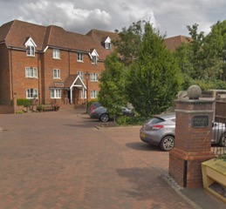
MOVEMENT
have an entrance that provides a clear demarcation between public and private space
have no more than 10 spaces in each court (12 for flats)
be well lit
have submitted with the application details of maintenance and utility arrangements
Parking courts, where proposed, should be located to the front, rear, or side of dwellings and ensure surveillance and security of vehicles. The image below indicates how a parking court to the front of dwellings can be achieved as shown on the images below.
Rear and side parking courts must be entirely enclosed with 1.8m high brick walls and have direct access from the court through lockable gates to the properties they serve.
Parking courts shall be surfaced in black tarmacadam and the vehicular entrance demarked by a change in surface.
Indicative Arrangement: On-Street Frontage Courtyard
M.3.i. PARKING
ON-STREET
IN CURTLIAGE
On-street parking is informal and unmarked for use by visitors or overflow parking for residents; It will be overlooked by surrounding houses and have a traffic calming effect, separating pedestrians from moving traffic.
To discourage parking on grass verges measures must be designed into landscape proposals with various methods explored such as edge posts and planting.
Within residential areas most house types should provide off-street parking. The parking should be provided within garages or hard surface areas and be located to the side of dwellings.
Coopers Wharf, Buckingham
1) On street parking at part of a courtyard/cul-de-sac arrangement
2) Residents can easily view and access their cars
3) Cars stored away from street frontage
4) Street trees used to help screen view of parked vehicles
PARKING COURTS
All parking courts shall:
have limited use in the layout
be used equally between free market and affordable housing

Slide 21
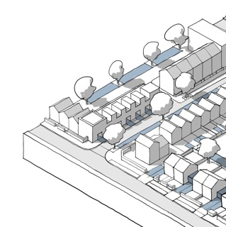
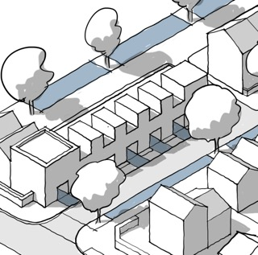
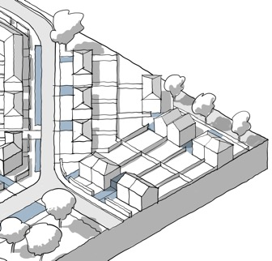
MOVEMENT
GARAGES
All single garages will be 6m x 3m (internal). All double garages will be 6m x 6m (internal) and should have two separate doors. Garage doors should be 2.5m wide to enable a vehicle to access and exit with ease and to encourage their use.
M.3.i. PARKING
Indicative Arrangement: On-Street Parking
Indicative Arrangement: On-Plot Undercroft
Indicative Arrangement: On-plot
Parallel parking to the frontage as part of a parking bay
Residents can easily access and view their cars.
Street trees will help demarcate the parking area and soften the view of parked cars
Buildings designed to allow for ground level parking space within the building footprint. This could lead to a garage at the rear of the plot.
Design solution helps to create a continuous building line and stores vehicles away from the frontage.
Drive to the side or rear of the plot, which could lead to a garage
Space for vehicle to safely pull in from the carriageway

Slide 22
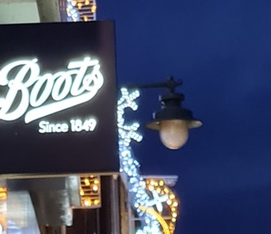
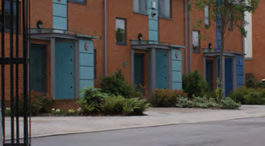
MOVEMENT
M.3.iii. SERVICES & UTILITIES
STREET NAMEPLATES & LIGHTS
Nameplates - Fixed to buildings, walls, or railings.
Street Lights - Attached to buildings where/if possible.
AEDs: DEFIBRILATOR ACCESS
Wall streetlights in the Buckingham Conservation Area
In order to achieve the target of no individual in Buckingham being further than 400m from an Automated External Defibrilator, new developments further than 400m from an existing device are asked to lay suitable infrastructure to a publicly accessible point that could be used to install a defibrillator in the future. The best locations are accessible, well lit and easily described.
BIN STORAGE
Residential store to collection point
Inconvenient bin storage for residential properties, particularly long paths to the back of properties or involving steps, are rarely used as intended. Instead, residents will leave bins at the front of properties, close to their collection point. This can cause obstructions to paths and reduce access widths.
Convoluted access paths should be avoided, and sensitively designed bin storage as part of the house frontage should be used as an alternative.
Collection point to highway
25m
30m
House frontage bin storage examples: Oxford County Council Street Design Guide.

Slide 23
NATURE
The appearance and treatment of spaces between and around buildings is of equal importance to the design of the buildings themselves. New development should have a spatial and planting structure that reflects and compliments the surroundings of the site. Landscape considerations should be the starting point of the design and layout.

Slide 24
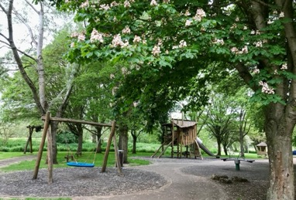
NaTURE
N.1.ii OS PROVISION
N.1.ii. DESIGN
VALP standards, or any replacement thereof, as set out in policy I1 and I2 for quantity, location and types of open space provided, following ANGSt guidelines, should be followed.
Mini woodlands would also be supported on large sites
There should be a clear distinction between public and private space, particularly in locations that adjoin the public realm. Secure access is required to all private internal and external areas.
A Landscape Strategy for each proposed development shall be prepared to reinforce the urban design and enhance the ecological and amenity value of the sites and their immediate surroundings. The key landscape design principles of this strategy will be that the proposal:
responds to the character of the site and its surroundings and local open spaces.
reinforces a hierarchy of avenues and open spaces.
strengthens site permeability and integrates pedestrian, cycle, and vehicle movements.
identifies opportunities for communal/allotment/amenity spaces for their significant townscape value.

Slide 25
Nature
Play areas
New play areas should be visible from surrounding homes and buildings.
Play areas should be LEAP and NEAP only.
Play areas next to roads, of any size, should be fenced. Where fencing is used there should be 2 gates for access.
Play areas sited as part of open space, away from roads and cyclepaths, should not be fenced.
Across each neighbourhood, play equipment should be included for children from infants to teenagers. Play area layout and design should be attractive to children of the appropriate age to use the play equipment at that site.
Older children’s play equipment should be separated from equipment for young children.
Play areas for teenagers should always be unfenced.
Play equipment should comply with RoSPA and Fields in Trust, or latest equivalent code.
Where play areas are to be built on sites liable to flooding, flood resilience measures, including ease of cleaning should be considered.
N.1.iii. OPEN SPACE DESIGN
Cycleways and footpaths in open spaces
Lighting
Cycleway (width)
Footpath (width)
In key areas
3m
2m
Additional width should be allocated on paths in open spaces to allow wheelchair users to pass.
Cycleways through open spaces should be lit
Footpaths should be lit at key locations, including junctions, gates and entry points.
Nature friendly lighting options should be used where appropriate.
Cycleways and footpaths should follow desire lines to town centres, schools and shops, linking existing paths in a logical manner.
Layout
Areas designed for sports, leisure, nature or play should be well defined and suitable for the assigned uses. Placement of seating and bins should reflect and not obstruct the planned layout.

Slide 26
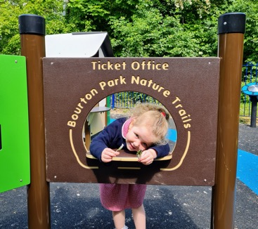
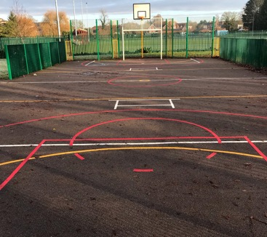
Play
Natural, fun and challenging, spaces to play and socialise for children and adults, young and old, are part of the context of Buckingham.

Slide 27
NaTURE
Resilient approaches should consider the practical consequences before, during and after a future flood:
Stilts or underground parking garages must consider how the underground level can be cleaned post-flooding eg SUMP & PUMP incorporated into design.
No hazards, including electricals, boilers or other fire or gas leak risks to be sited in parts of the site identified as at flood risk.
Residents and vehicles must be able to leave the property if a flood is imminent or in process through a safe emergency access route. “safe refuges” are not considered appropriate.
N.2.ii SUDS
See also Buckingham Neighbourhood Plan Policy I1 Water management and flood risk
In addition SUDs to be incorporated with street trees on primary and secondary streets.
Use of SUDs at individual properties could include:
permeable surface driveways, green roofs and walls, rain capture devices, soakways, rain gardens and other similar approaches.
Reedbeds and wetlands for nature use and flood attenuation will be supported alongside the river, particularly in areas identified as also bringing environmental benefits with the addition of wetlands.
N.2.i. WORKING WITH WATER
Buildings near the river should face the water. They must leave a sufficient buffer zone to allow for watercourses and banks to be maintained and for current and potential future flood defences.
A buffer zone should be maintained along river - walking and cycling routes along watercourses should be included where appropriate – particularly along the entire stretch of River Great Ouse.
Bridges could be added to allow a public foot or cyclepaths along the river.
Opening up culverts, reinstating meanders and restoring and naturalising river beds will all be supported where appropriate.
N.2.iii FLOOD RISK
Resilient design approaches are to be used where there is some risk of flooding.

Slide 28
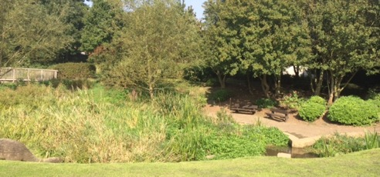
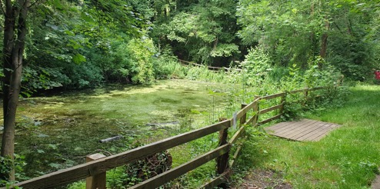
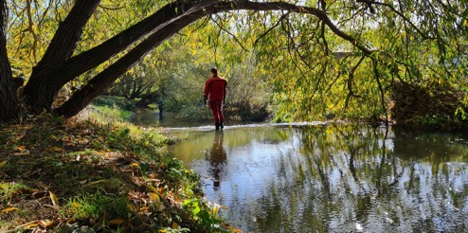
Nature
N.3.i. NET GAIN
Bourton Park Ponds
Where Biodiversity Net Gain cannot be delivered on site opportunities identified in the Ecological Assessment evidence base for the Neighbourhood Plan should be considered for offsite Biodiversity Net Gain. See also Neighbourhood Plan policy ENV2 Green and Blue Infrastructure.
The following sites are owned by Buckingham Town Council, who would welcome discussions about their use for offsite Biodiversity Net Gain.
Ponds at Bourton Park
Railway Walk
Riverside Walk
Railway Walk
Riverside Walk

Slide 29
Nature
PLANTING
Plant species, along with sizes and locations, within new development schemes in and adjoining Buckingham are critical to support the rich biodiversity and landscape character of the local area.
A multi-layered planting strategy is required across all sites; trees, hedgerow boundaries, open spaces, gardens, and grassland verges, to allow for a range of vegetation heights and habitats across the development informed by site specific landscape character assessments.
Front garden hedges adjacent to footways can be successfully created from a mixture of hornbeam, beech and hazel for example, to maintain a locally distinctive, semi-rural character in new developments.
N.3.ii. BIODIVERSITY
DESIGN APPROACHES
See also Neighbourhood Plan Policies ENV1 Buckingham Green Ring and ENV2 Green and Blue Infrastructure; for planting see Buckingham Neighbourhood Plan Policy ENV3 Urban greening.
Layout scheme should be designed around or incorporate existing landscape features, such as mature trees, hedgerows, and other landscape elements worthy of retention.
Retains and enhances opportunities for wildlife penetration into developments by the reinforcement and retention of local habitats.
Provides safe and secure environments for inhabitants through the disposition and detail of landscape elements.
Reinforces any existing perimeter vegetation with appropriate native planting to establish an effective buffer between proposed developments and adjacent areas.
Concentrates soft landscaping areas within the site.
Handles and stores topsoil carefully to preserve and re-use this valuable resource.
Native hedging plants and shrubs which can be coppiced, such as hazel, hawthorn, guelder rose, dogwood, and field maple.
Orchard type trees such as apples, crab apples, and cherries.
‘Structural’ hedgerow and specimen trees such as oak, hornbeam, field maple, and birch, including new mature trees. Black poplar should be included where appropriate.
Areas of the ubiquitous, ‘estate’ planting of ornamental ground-cover shrubs (such as Berberis, Pyracantha, Photinia and Mahonia) are not appropriate in developments within Buckingham.
Non-native or invasive species such as laurel, leylandii, buddleia, European bluebells, rhodedendron should also be avoided.

Slide 30
NaTURE
Roundabout street trees
Open Spaces
Dwelling frontages and hedges
DWELLINGS
Extra heavy standard 18cm plus girth with necessary protection measures.
Semi Mature 35cm plus girth with necessary protection measures.
900mm tall at time of planting. 5 plants per linear metre.
All new dwellings shall be fitted with Swift boxes or Swift bricks together with Bat boxes/bricks. These shall be positioned as recommended within the applicants’ ecology report/study and by Buckinghamshire Council’s Ecologist.
N.3.iii. STREET TREES
Suitable trees and planting could include the following specimens:
Choice of street trees should be made on the basis of an assessment the site and use, rather than any other factor:
Consideration for flooding, drought, likely root size, form, deciduous and nearby structures
Function of trees in each location should be considered eg, to clean air, to provide shade, to filter noise
Services for utilities should not be positioned where they are likely to be disturbed by the growth of street trees
Use of tree guards or fences can be considered where appropriate eg high traffic areas
To aid biodiversity a wide variety of street trees should be used. Repetitive use of the same small group of trees or hedging across a new development should be avoided.
Tilea Cordata ‘Greenspire’ (Small Leaf Lime); Acer Campestre ‘Elsrijk’ (Field Maple); Butula Pendula (Silver Birch); Prunus Avium ‘Plena’ (Wild Cherry).
Fagus Sylvatica (Common Beech); Acer Campestre (Field Maple); Malus Sylvestris (Crab Apple); Quercus Robur (English Oak), Quercus Rubra (Red Oak); Ulmus Procera (English Elm); Farxinus Excelsoir (Ash); Tilea Cordata (Small Leaf Lime).
Blackthorn, Hawthorn, Holly, Privet, Hornbeam, Beech, Hazel.

Slide 31
IDENTITY
I.1.i. LOCAL CHARACTER
BOUNDARY TREAMENTS
Estate railing
Black painted metal
Boundary treatments heavily influence the characteristics of a street and demarcate division between the public and private realms.
The boundary treatments to be used within new developments should include:
Metal estate railings painted black to front gardens (including gates).
1.8m high brick garden walls where plot boundaries adjoin the public realm.
Close boarded fence to rear/side boundaries only where they adjoin neighbouring gardens that do not front onto the public realm.
Railings with planting behind; new planting should be native species only as recommended earlier in this document.

Slide 32
IDENTITY
I.1.i. LOCAL CHARACTER
WORKING WITH SITE FEATURES
See also Design Code Policy Nature N.3.ii Design Approaches
Use existing site features to create/retain character, such as:
Include retained buildings into new blocks.
Allow existing levels to suggest layout option.
Use ponds and watercourses for outlook.
Use specimen trees as the focus for new developments.
Use hedgerows to create structure.
Front new buildings onto established routes.
Formalise informal routes.
Aerial view, Bernadines Way
Google Maps © 2024
Houses in Bernadines Way designed around the existing mature Oak tree.

Slide 33
IDENTITY
I.2.i. DESIGN OF BUILDINGS
To ensure that local distinctiveness is realised within proposed housing developments the following standards will apply.
Angle of roof slope
Brick bonding
Stonework
Height
maximum 35 degrees where natural slate is used and 50 degrees maximum where plain clay tiles are used.
the external face of 2 ½ and 3 storey buildings shall be laid in Flemish bond
Guillotine cut local limestone coursed as per local practice.
Height from DPC to eaves shall be greater than height between eaves and ridge.
Span depths
Ridge heights
5.5m to 8.5m maximum
7m – 8.5m maximum
Chimney
Flat brick voussiors
Round brick voussiors
Colour
Chimneys on all dwellings with pitched roofs, which should be usable for venting purposes.
Use of coloured window frames and front doors, such as green, blue, grey, and black (and red for doors), as opposed to 100% white, to add variety.
Flat arch brick voussiors to window heads (to match the brick used for the proposed building).
Brick to match building. Window frames shall be curved at the top to fill the opening
Window heads
Window and door reveals
1st floor window heads to adjoin eaves.
minimum 100mm

Slide 34
IDENTITY
EXTERNAL MATERIALS
BRICKS
ROOF COVERINGS
Red/orange brick, occasional yellow brick (that matches the local hue), natural limestone, stucco/render of varying colours, plain clay tiles, and natural slate to be used throughout all proposed developments.
As of 2024 the following bricks and roof coverings are recommended to accord with the local distinctiveness of Buckingham.
Natural Limestone – guillotine cut
Wienerberger
Waresley Orange Stock, Warnham Terracotta Stock, Smeed Dean Belgrave Yellow Stock
Ibstock
Eclipse Leicester Red Stock, Elliston Leicester Orange Stock, Leybrook Imperial Red Stock
Leybrook Imperial Yellow Stock, Parkhouse Mellow Regent Stock
Redland Rosemary Clay Plain Tile – Burnt Blend
Natural Slate Tile e.g. Passaro SS65F Blue/Grey
Where contemporary designs are proposed the above code may be relaxed should the proposal reflect the local distinctiveness of Buckingham.
New dwelling within Lace Hill designed and built to reflect the local distinctiveness of Buckingham in terms of design features and materials.

Slide 35
PUBLIC SPACES
It is important that all new developments include pedestrian, mobility scooter, and cycle links to the existing network to enable residents to move safely through the town, whether on foot or cycle, creating easy access to Buckingham’s parks and open spaces together with schools, retail, sporting and employment areas.
All new developments should include infrastructure relevant to recommendations by Active Travel England to make all short journeys easily accessible for cycling and walking, and mobility scooters. See also CLH1 Active and sustainable travel.
Footpaths must be continuous along streets to avoid crossings of the carriageway.
P.1.i. PRIMARY
The primary street will provide direct vehicular access to the residential area as a whole. It also plays an important function within the public transport network, as a bus route may be accommodated. The primary street will be defined by a tree lined avenue with trees planted within a 2 metre grass verge adjacent to both sides of the carriageway. The primary street will also include a combined footpath cycleway to one side.
Swept path requirement (minimum)
Combined Footpath/ cycleway (width)
Planting
Refuse collection vehicles, emergency vehicles and public transport vehicles
Native tree species to be agreed with highway authority
Design speed
Carriageway (width)
Kerb
Footpath (width)
3m
20/30 mph
6.5m – 7.3m
Conservation style
1.8m minimum

Slide 36
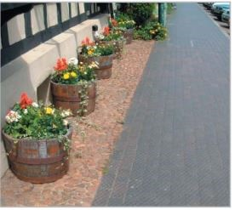
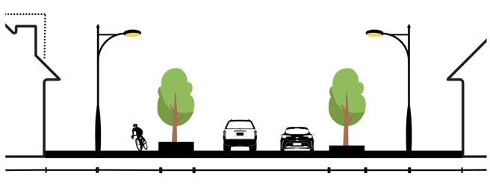
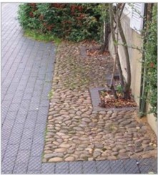
PUBLIC SPACES
PRIMARY STREET LAYOUT
1 – 2.5 storey high frontage
2 – 2.5 storey high frontage
1m min wide Front Garden
3m wide footpath/ cycleway
2m wide grass verge
6.5 – 7.3m wide carriageway
2m wide grass verge
1.8m wide footpath
1m min wide front garden
The images to the right indicate how differing surface materials define the difference between the public and private realms. Where railings or fences are not used, particularly in shared areas, then examples such as this should be followed.

Slide 37
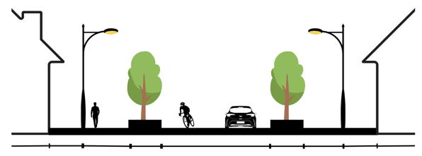
PUBLIC SPACES
P.1.ii SECONDARY STREETS HIERARCHY
These roads link neighbourhoods and feed the lower order roads. The secondary street is defined by informal trees planted in the verge and occasional tree planting in grates within a widened footpath.
2 – 2.5 storey high frontage
2 – 2.5 storey high frontage
1m min wide Front Garden
1.8m wide footpath
2m wide grass verge
6m wide carriageway
2m wide grass verge
1.8m wide footpath
1m min wide Front Garden
Traffic calming
Swept path requirement (minimum)
Planting
through carriageway alignment, junction surface treatments, and changes in priority.
Native tree species to be agreed with highway authority
Design speed
Carriageway (width)
Kerb
Footpath (width)
Refuse collection vehicles, emergency vehicles
20 mph
6m
Conservation style
1.8m minimum

Slide 38
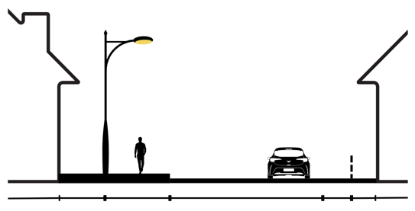
PUBLIC SPACES
P.1.iii. TERTIARY STREETS HIERARCHY
More informal roads serving a limited number of dwellings. These will have a footpath to one side of the carriageway and a service strip on the other side.
2 storey high frontage
2 storey high frontage
2m min wide Front Garden
1.8m min wide Footpath
Varied width Carriageway min 4.8m wide
1m min wide Service Strip
1m min wide Planting strip
Traffic calming
Swept path requirement (minimum)
Planting
surfaces/street furniture that clearly delineates public and private spaces, with planting and landscape elements designed into street layout as calming measures.
Native tree species to be agreed with highway authority
Design speed
Carriageway (width)
Service strip
Footpath (width)
Refuse collection vehicle and emergency vehicles
20 mph
Variable minimum 4.8m
1m
1.8m minimum

Slide 39
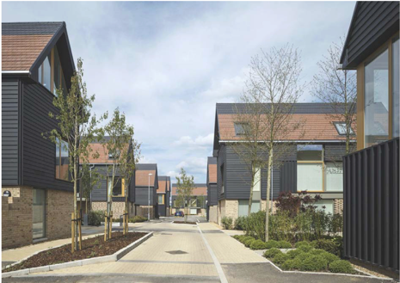
Public Spaces
P.2.iii. HOME ZONES
Shared surface streets will not normally be supported, without physical barriers to prevent access by vehicles to cycling and walking areas.
Home Zones should be places where people and vehicles and street space safely, with quality of life taking precendence over the movement of traffic. In order to do this, vehicle speeds must be reduced to walking pace.
Home Zones could form part of a ‘Play Streets’ approach.
The use of physical barriers in proposed Home Zones is essential, and the preferred approaches are:
Street furniture: can also create seating opportunities
Planting: planters, trees and other green features
Cars: speeds reduced to walking pace
Signs: should clearly mark the entrance to the zone and, where relevant, children crossing
Example of use of physical features to prevent vehicle access, National Model Design Code

Slide 40
Public Spaces
P.3.i. SECURED BY DESIGN
Some parking to be provided in front of shops, separated from the village green & garden square.
Town squares, which use majority hard standing surfaces, are not supported, except within high density communal courtyards eg student accommodation or flats. Where Town Squares are used, green elements should also be included, planting, trees and water features.
The enclosure ratio of all meeting places will be such that the shortest side of the square at least twice the height of the surrounding buildings
Power supply and lighting should be present in all squares, at key points for example, entrances and path crossings.
Key routes, for walking/cycling not on roads should be lit where possible, nature friendly lighting can be considered.
P.3.ii. COUNTER TERRORISM
Vehicle access should be restricted at the edge of open spaces and around community buildings. Removable bollards should be used at key points for maintenance access.
P.2.i. MEETING PLACES
Village Green
Town Squares
Garden Square
Use of Village Greens and Garden Squares within new developments is supported. The meeting place should be surrounded by active frontage: schools, community centres and shops, restaurants and other community infrastructure will be centered around this green meeting space.
Green meeting places should include play facilities as well as substantial green space as a meeting place for other users including open space and benches. The size of the play area should correspond with the guidelines quoted under Open Space Design, with a minimum of ¾ of the remaining space allocated for other green space purposes.

Slide 41
HOMES AND BUILDINGS
H.1.i SPACE STANDARDS
H.1.ii ACCESSIBILITY
As a minimum all new dwellings shall accord with the Nationally Described Space Standard dated March 2015 and any subsequent variations thereof.
The requirements of VALP H6c are supported, however it is considered that Buckingham also has a need for M4(3) Category 3: Wheelchair User Dwellings in open market homes as well as Affordable Homes.
Relevant proposals will be required to meet these standards or equivalent successor standards. The introduction of this requirement will contribute towards improving the overall housing stock of Buckingham and will enable more residents to live independently for longer in their own homes. This will help provide an improved range of housing that meets the needs of current and future generations.
Accessible and adaptable dwellings are required for households of any age that experience disability or frailty, or who need
homes that can accommodate intergenerational living. Such dwellings are also well suited for people looking for retirement living accommodation which in turn will lead to the release of existing family homes onto the market. The provision of level access bungalows and level access flats/apartments, that promote and maintain people’s independence is particularly likely to capture demand from these groups. The specific measures incorporated into schemes will need to demonstrate compliance with the relevant accessible and adaptable standard.
Buckingham Town Council encourages proposals for houses, bungalows and apartments/flats to go beyond the minimum policy requirements set out above. Provision of 15% M4(3) homes on site is recommended subject to local needs evidence.

Slide 42
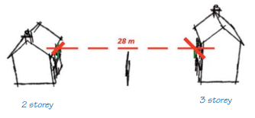
HOMES AND BUILDINGS
H.2.i LIGHT, ASPECT & PRIVACY
FRONT/BACK TO SIDE
SPACE BETWEEN DWELLINGS: FRONT TO FRONT
Where principal windows face the wall of a 2 storey dwelling that contains no windows, or windows that contain obscured glass (e.g. bathrooms) the minimum distance shall be 14 metres. If the facing wall is 3 storeys high (with no windows) the minimum distance shall be 17 metres, increasing by 3 metres for each additional storey.
Where 1 or 2 storey buildings face a building of similar height a minimum distance of 22 metres should be maintained between the principal windows of the dwellings.
Where one or both facing dwellings are more than 2 storeys high the minimum distance between principal windows shall be 28 metres plus an additional 3 metres setback for each additional storey.

Slide 43
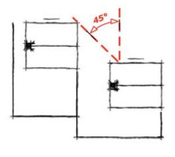
HOMES AND BUILDINGS
See Buckingham Neighbourhood Plan Policy ENV4 Private Outdoor Space
BACK TO BACK
45 DEGREE RULE
Where the rear elevation of a 1 or 2 storey dwelling faces the rear elevation of a 1 or 2 storey dwelling a minimum distance of 22 metres shall be maintained. If one of the dwellings is 3 storeys high than a minimum distance of 28 metres shall be maintained, increasing by 3 metres for each additional storey.
New buildings that are sited close to the principal windows of existing properties shall be designed so that there is no obstruction to daylight beyond a horizonal angle of 45 degrees, measured on plan view, from the nearest jamb of the principal window of an adjoining property.
New buildings that are proposed to be sited facing principal windows of existing properties shall be designed so that there is no obstruction to daylight beyond a vertical angle of 45 degrees measured from the nearest jamb of the principal window(s) of an adjoining property.
BALCONIES FOR FLATS/APARTMENTS
Whether these are located internally from the face of the building, or attached externally, balconies will have a minimum floorspace of 4 square metres to allow functional use.

Slide 44
HOMES AND BUILDINGS
H.2.iii. GARDENS AND BALCONIES
1 bedroom flat
2+ bedroom flat
Please see Buckingham Neighbourhood Plan Policy ENV4 Private Outdoor Space
MINIMUM RECOMMENDED OUTDOOR AMENITY SPACE
20 m²
40 m²
MINIMUM SPACE STANDARDS - EXTERNAL
The distance between dwellings and the treatment of spaces around them have an important effect on the appearance of an area and the quality of life for residents, and for the development’s distinctiveness. Sufficient space should be provided to meet the outdoor needs of the household including children’s play, hobbies, outdoor relaxation, drying of washing and greenery.
Outlook from a dwelling is allied to privacy and both are necessary for quality of life in dwellings. Whilst an adequate standard of privacy may be achieved by the use of walls, fences or planting.
Consideration will need to be given to the outlook that would then be achieved, as an enclosed or cramped outlook from habitable rooms is likely to be oppressive.
The provision of enclosed private outdoor amenity space should be incorporated in the early stage of the design process. Amenity space for all dwellings shall be:
Private, useable, functional, and safe.
Easily accessible from living areas.
Orientated to maximise sunlight.
Private amenity space shall not be steeply sloping or awkwardly shaped to prejudice its function to accommodate relaxation and leisure activities of residents.
2 bedroom house
3 bedroom house
50 m²
65 m²
For each additional bedspace add
4 bedroom house
75 m²
5 m²

Slide 45
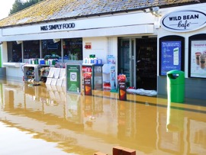
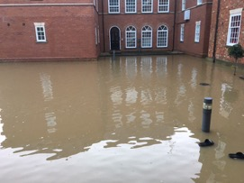
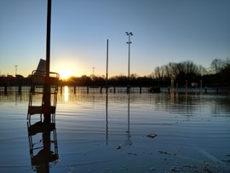
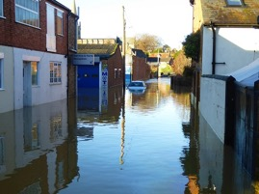
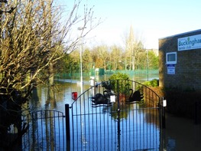
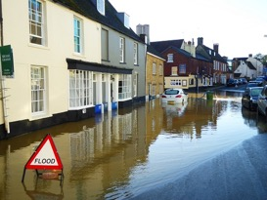
RESOURCES
R.2.iv. WATER
CLIMATE CHANGE AND FLOODING
More intense rainfall in recent years has led to more regular flooding within Buckingham, see Buckingham Neighbourhood Plan Policy I1 Water management and flood risk.
In addition the following applies:
a) not culverting, building over, creating structures or crossings in, or altering watercourses in a manner which may harm the physical environment, ecology, or hydrology of the watercourse wherever practicable; and
b) encouraging catchment management through the removal of existing culverts and other hard engineering structures and the introduction of natural flood management measures including river restoration, appropriate tree planting, upstream flood storage and wetland habitat creation.

Slide 46
RESOURCES
R.2.iv. WATER
WATER RECYCLING
RAINWATER HARVESTING
Water used in homes has long been thought of in terms of clean drinking water (known as potable water) coming into the house from the mains and sewage going out. However, the wastewater from baths, showers, washing machines, dishwashers and sinks is referred to as greywater, which typically makes up between 50-80% of a household’s wastewater.
If recycled properly, greywater can save approximately 70 litres of potable water per person per day in domestic households, therefore greywater recycling is one of several water solutions that developers should look to when constructing new developments to help decrease usage of this valuable resource.
A rainwater capture system collects rainwater falling on roofs and other surfaces, filters it and diverts it into a rainwater storage tank and then pumps it around a dwelling for use in flushing toilets, supplying outside taps or in some cases washing machines.
As with water recycling this should be considered by developers as a system to be installed in all new properties.

Slide 47
planning applications
SUBMISSION OF PLANNING APPLICATIONS
FURTHER GUIDANCE
At the submission stage, whether ‘outline’ or ‘full’, the prospective developer will provide a statement, and include external material details, stating that the proposals are fully in accordance with these codes.
Where they are unable to do so the onus will remain with the applicant to explain why.
In relation to other developments, extensions, shop fronts etc, the following supplementary planning guidance can be found within the Buckinghamshire Council website under Planning Policy.

